Slide 1
Implementing Stateless Clients in Ethereum
Souvik Banerjee
Advisor: Vijay Chidambaram Second Reader: Chris Rossbach Third Reader: Alan K. Cline
Notes:
10 seconds

Slide 2
Outline
Motivation
Background
Stateless Clients
Implementation
Results
Conclusions and Future Work
Notes:
30 seconds

Slide 3
Blockchain
A decentralized data sharing technology
Records transactions in an immutable ledger
Used in many applications
Notes:
45 seconds
To motivate the problem my research is trying to solve, I want to first discuss what blockchain is. Blockchain is a decentralized data sharing technology
At its core, blockchain is an immutable ledger of transactions
The immutability of blockchain makes it useful for a wide variety of applications…
The most well-known applications of blockchain are cryptocurrencies like Bitcoin and Ethereum
But there are other applications of blockchain such as in real estate and the pharmaceutical industry
Companies like IBM also offer blockchain as a service

Slide 4
Ethereum
A cryptocurrency (1 ETH ≈ 166 USD)
A platform for blockchain applications
Blockchain applications are written using smart contracts
Notes:
45 seconds
1. In this talk, I will be focusing on Ethereum in particular.
2. Ethereum is a platform for blockchain applications
3. The most popular application is the Ether cryptocurrency
4. But Ethereum is extremely flexible and supports blockchain applications through smart contracts

Slide 5

Smart Contracts
Computer programs that run in a secure environment
Written in Solidity
Turing-complete programming language
Applications
Notes:
2 minutes
0. Smart contracts are <click> computer programs that run in a secure environment
2. In Ethereum, they are written in a Turing-compelte programming language called Solidity
3. THere are many Ethereum applications that use smart contracts. Some notable ones are
4. The Decentralized Autonomous Organization which is a decentralized venture capital fund
5. Etheroll, which is a Ethereum gambling platform
6. Cryptokitties, which is a service that lets you collect digital cats similar to Neopets

Slide 6
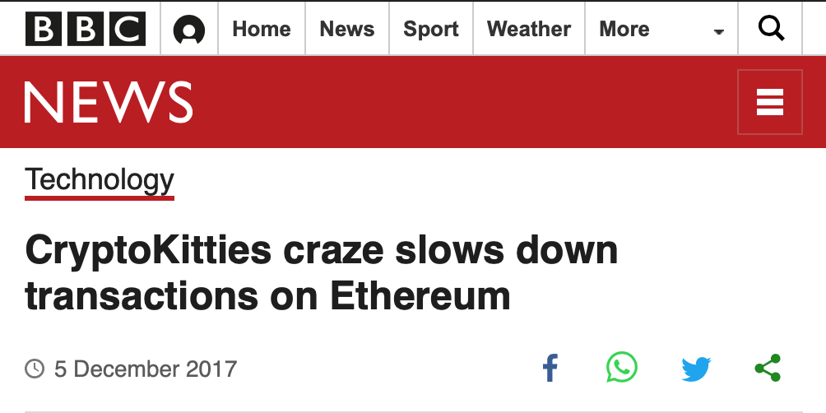
Ethereum Scalability
Ethereum can only process ~15 transactions/second
Visa can process 24000 transactions/second
Smart contracts also contribute to slow transaction throughput
Notes:
1 minute
0. Although Ethereum is a very extensible platform, it currently suffers from scalability problems
1. For a point of comparison, Ethereum can only process 15 transactions per second, while the payment processor Visa can process 24000 transactions per second
2. The smart contracts on Ethereum also contribute to slow transaction throughput. There was an article published by the BBC stating that the Cryptokitties contract was slowing down transactions on ethereum.

Slide 7
Ethereum Scalability: I/O
Reducing I/O may improve transaction throughput
Stateless Clients is one proposed solution
Notes:
1. One reason for the slow transaction throughput in Ethereum is I/O. The graph on the right shows how number of I/O operations and block verification time are correlated. Block verification time is a measure of how long it takes transations to be confirmed by the Ethereun network. More I/O operations typically results in longer verification times.
2. One potential solution to this problem is called Stateless Clients. Stateless Clients is a proposal to reduce I/O in Ethereum and improve transaction throughput, and is the main focus of this talk. But before I talk about stateless clients, I want to first review some background information about Ethereum.

Slide 8
Ethereum Internals: Outline
Transactions
Blocks
RLP Encoding
Merkle-Patricia Trie
State Transition Function
Proof-Of-Work (PoW) Consensus
Notes:
Here's an outline for the background material section of this talk

Slide 9
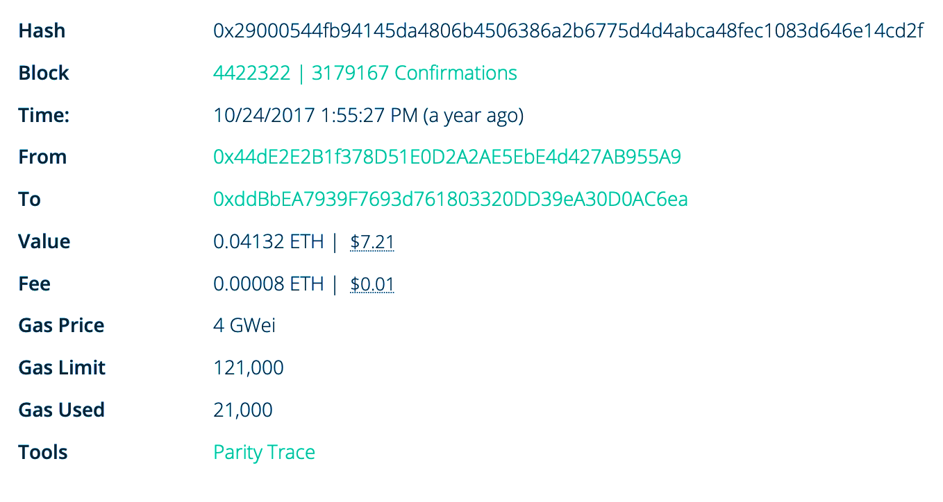
Transactions
How the outside world communicates with Ethereum
160-bit account addresses
Notes:
The first topic I want to discuss is how transactions work in Ethereum. Transactions are how the outside world communicates with Ethereum. (click)
Transactions have senders and receivers. The image on this slide shows what an example transaction looks like. Transactions have many components but the two I want to highlight are the from and to addresses. The hex values are Ethereum account addresses.

Slide 10
Blocks
Blocks contain many transactions and a block header
Hashed with SHA-3
Notes:
Transactions are grouped into blocks. Each block contains some amount of transactions and metadata about the block, which is stored in the header. There are many fields in the block header, but the one I want to highlight is the parent block hash field. Every block in Ethereum is hashed with the SHA3 hash function. In this example, the hashes of each block is listed below the block. The parent block hash field in each block's header is the hash of the previous block. This makes a block's SHA3 hash dependent on the hashes of all the blocks before it. This is where the immutable ledger property of the blockchain comes from. It is not possible to modify a previous block without someone finding out since that changes the hashes of all the blocks after it.

Slide 11
RLP Encoding
Recursive Length Prefix
Encoding scheme for serializing data structures
Similar to JSON, but only supports lists and binary data
Notes:
Another important technical detail about Ethereum is that all data structures are encoded using Recursive Length Prefix encoding. RLP encoding is a custom serialization format made for Ethereum that is similar to JSON, but it only supports binary data and nested lists.

Slide 12
Merkle-Patricia Trie
How Ethereum stores account balances and other metadata
Ethereum world state
Builds upon both Merkle trees and radix tries
Nodes are serialized with RLP and link to child nodes by their SHA-3 hash
Hashes for child nodes are stored inside the parent node
Hash of a node depends on hashes of its children, which are dependent on the hashes of grandchildren, etc.
Hash of the root node uniquely identifies the entire trie
Notes:
0. The next topic I want to discuss is the Merkle-Patricia trie.
1. The Merkle-Patricia trie is a data structure that Ethereum uses to store account balances and other data. This account balance trie is also called the Ethereum world state.
2. This data structure builds upon concepts in both Merkle trees and radix tries.
3. In this data structure, the nodes in the trie are serialized with RLP and hashed with the SHA3 hash function. Nodes connect to their child nodes by their hash, and these hashes are stored inside the parent node. This makes the hash of a node dependent on the hashes of its children, which are dependent on the hashes of grandchildren, and so on. So the hash of the root node of the trie can be used to uniquely identify the whole trie.

Slide 13
Merkle-Patricia Trie
Notes:
Here is an example Merkle-Patricia trie. This trie contains four accounts and their balances are shown in the diagram. The non-leaf intermediate nodes contain the hashes of their children.

Slide 14
Merkle-Patricia Trie
Merkle-Patricia trie nodes are typically stored in a key-value store
LevelDB, RocksDB
“Pointer-chasing”
Random I/O operations
Notes:
0. Since each node in a Merkle Patricia trie is hashed with SHA3, storing the nodes in a key-value store is a natural thing to do. The key is the SHA3 hash and the value is the actual node data. The diagram here shows what the trie from earlier would look like when stored in a key-value store.
1. A consequence of storing tries in this format is that traversing the trie results in non-sequential I/O patterns. Additionally, the I/O pattern is kind of like pointer chasing in that you have to read one node to get the hash of the next node, which is not possible to parallelize.

Slide 15
Merkle-Patricia Trie
Can be used to verify values in the trie (Merkle proof)
Merkle Proof of a value v
Hashes of sibling nodes along path from root to v
The value v
Notes:
0. Another important property of Merkle-Patricia tries is that they can be used to verify that a particular value exists in the trie. This is called a Merkle Proof.
1. A Merkle proof of a value is simply the sibling nodes in the trie along the path from the root to the value
2. Merkle Proofs are useful because you can verify that a value exists without needing access to the whole trie. If you only know the root hash of the trie and you have a Merkle proof of a value, it is possible to verify that the value must exist in the trie.

Slide 16







Merkle-Patricia Trie
$$N_{1}$$
Root Node.
Children: [0x3244…f31e, 0x5484…20f1]
$$N_{2}$$
$$N_{3}$$
Non-leaf Node. Children: [0xf45e…3789, 0xa38c…f32b]
Non-leaf Node. Children: [0x78b4...4bc7, 0x983b…ff3e]
Leaf Node. Balance: 100 ETH
Leaf Node. Balance: 10 ETH
Leaf Node. Balance: 12 ETH
Leaf Node. Balance: 50 ETH
$$N_{4}$$
$$N_{5}$$
$$N_{6}$$
$$N_{7}$$
Notes:
This slide shows the Merkle proof for the account with balance of 12 ETH. The sibling nodes are shown in orange, and the node in green is the leaf node for the account. I also numbered the nodes N1 through N7.

Slide 17

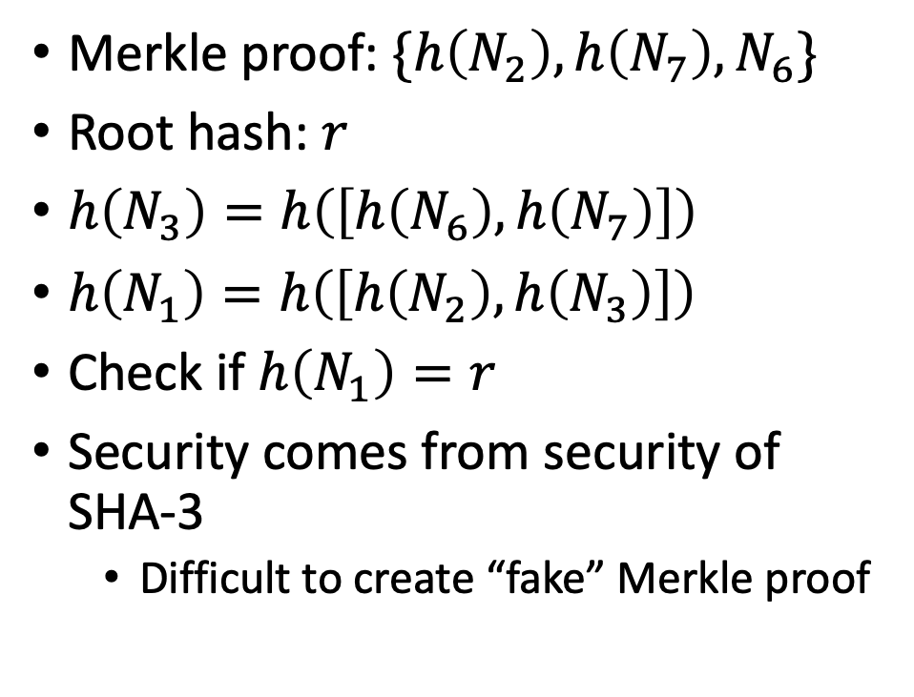






Merkle-Patricia Trie
Merkle proof: $\{h\left(N_{2}\right),h\left(N_{7}\right),N_{6}\}$
Root hash: $r$
$h\left(N_{3}\right)=h\left(\left[h\left(N_{6}\right),h\left(N_{7}\right)\right]\right)$
$h\left(N_{1}\right)=h\left(\left[h\left(N_{2}\right),h\left(N_{3}\right)\right]\right)$
Check if $h\left(N_{1}\right)=r$
Security comes from security of SHA-3
Difficult to create “fake” Merkle proof
$$N_{1}$$
$$N_{2}$$
$$N_{3}$$
$$N_{4}$$
$$N_{5}$$
$$N_{6}$$
$$N_{7}$$
Notes:
In this slide I'll show how you can use a Merkle proof to verify that N6 exists. The Merkle proof for N6 is shown here: it is the hash of N2, the hash of N7, and the value of N6. h is the SHA3 hash function. Also, assume that we know the expected root hash of the trie.
The first step is to figure out the hash of N3. The way we do this is by using the hashes of N6 and N7. We know the hash of N7 because that is part of the Merkle proof, and we can calculate the hash of N6. We also know that N3 is a non-leaf node, so the hash of N3 is the hash of the array containing the hash of N6 and N7.
The next step is to figure out the hash of N1. We repeat the same process by using the hash of N2 which we have from the Merkle proof, and the hash of N3 which we calculated in the previous step.
The last step is to check the hash of the root node N1 against the expected root hash r. If it matches then we know that N6 must exist in the trie.
The security of Merkle proofs depends on the security of the underlying hash function. The SHA3 hash function that Ethereum uses is so far thought to be secure and there are no known hash collisions. To break the security of Merkle proofs, you need to somehow get a hash collision.

Slide 18
Merkle-Patricia Trie
Equivalent definition of Merkle Proof:
Set of nodes from root to value
Non-leaf nodes contain hashes of children
Same as including sibling hashes
We will use this definition
$$N_{1}$$
$$N_{2}$$
$$N_{3}$$
$$N_{4}$$
$$N_{5}$$
$$N_{6}$$
$$N_{7}$$
Notes:
In this slide I want to discuss an equivalent definition of Merkle proofs that make them a lot easier to reason about and use. This definition is the set of nodes from the root to the value. In this definition, sibling node hashes aren't used directly, but this definition works because the non-leaf nodes contain the hashes of all their children. This is the same as including sibling hashes.

Slide 19
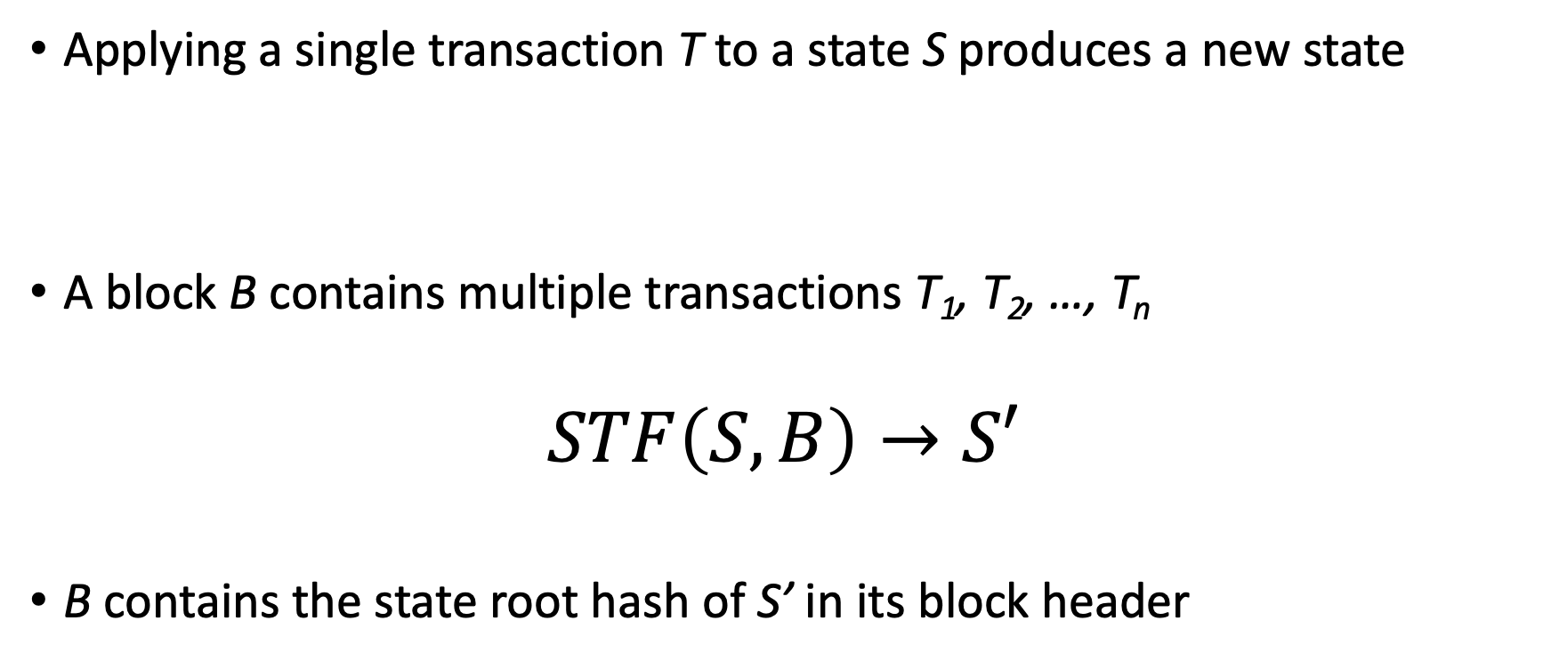
Ethereum State Transition Function
Applying a single transaction T to a state S produces a new state
A block B contains multiple transactions T₁, T₂, …, T_{n}
$$STF\left(S,B\right)→S′$$
B contains the state root hash of S’ in its block header
Notes:
0. Now that we discussed how Ethereum stores its state, I want to discuss the Ethereum state transition function.
1. In Ethereum, a transaction deducts some amount from one account and adds it to another account. This means that it takes some initial state S and produces a new state S'.
2. We can also extend this to multiple transactions, like the transactions in a block. Applying all of these transactions to an initial state S produces a new state S'. Also, blocks contain the state root hash of the new state S' in their header. This is kind of a self-check to make sure the transactions have executed properly.

Slide 20
Proof-Of-Work Consensus
Ethereum is a distributed system
Every node stores the blockchain and participates in verifying blocks
Miners create blocks from transactions they receive from users and send them to other nodes (verifiers)
Miners get rewarded
Verifiers get blocks, re-execute transactions
Notes:
The last topic in the background section I will discuss is Proof-Of-Work consensus.
Ethereum is a distributed system and the nodes to to achive consensus on the blocks in the blockchain. The consensus algorithm that Ethereum uses is called Proof-Of-Work consensus. Every node in Ethereum stores the blockchain and participates in verifying blocks.
Additionally, some nodes create blocks from transactions they receive from users. These nodes are called miners, while the nodes that only verify blocks are verifiers.
The technical details behind Proof Of Work aren't very relevant to this talk so I will omit them, but I do want to mention that Proof Of Work prevents abuse by requiring nodes to perform expensive tasks and provide proof that the task has been completed.
Another important detail about proof of work is that miners have an economic incentive to participate in proof of work. Miners get rewarded every time they successfully mine a block

Slide 21
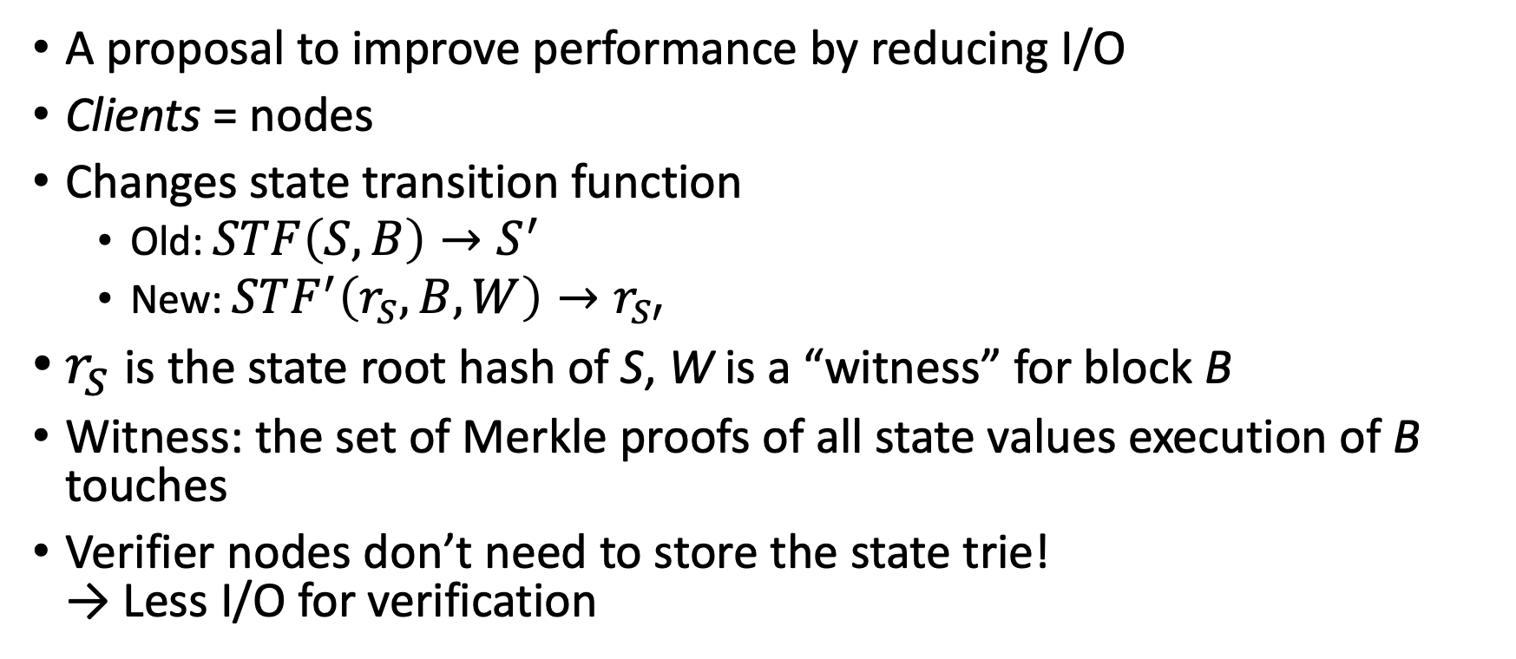
Stateless Clients
A proposal to improve performance by reducing I/O
Clients = nodes
Changes state transition function
Old: $STF\left(S,B\right)→S^{′}$
New: $STF^{′}\left(r_{S},B,W\right)→r_{S′}$
$r_{S}$ is the state root hash of S, W is a “witness” for block B
Witness: the set of Merkle proofs of all state values execution of B touches
Verifier nodes don’t need to store the state trie! → Less I/O for verification
Notes:
(16 minutes)
So now I'll discuss the main topic of this talk.
Stateless Clients is a proposal to improve the performance of Ethereum by reducing I/O.
One minor thing I want to note is that although they use the word client, it really means the same thing as an Ethereum node.
The way Stateless Clients work is by changing the state transition function. Here you can see the old transition function I showed earlier and what the new transition function is. The variables used in the new transition function are r_s, B, W, and r_{s'}. r_s and r_s' are the state root hashes of S and S' respectively. B is a block, and W is a witness for the block.
A witness is the set of Merkle proofs of all state values execution of B needs.
The key point of this proposal is that Ethereum nodes no longer need to store the Ethereum world state trie, which is why it's called stateless clients. This implies that there will be less I/O.

Slide 22
Stateless Clients
Witnesses are generated when blocks are created
Miner keeps track of what state values are needed to execute the block
Witnesses are sent along with blocks to other Ethereum nodes
Instead of using state trie, verifier nodes use the witness
Notes:
In Stateless Clients, witnesses generated when blocks are created. Miners still create blocks, but miners now also keep track of what state values are needed while executing the block.
These witnesses are sent along with blocks to other Ethereum nodes. Verifier nodes that don't have the state trie use the witness to verify blocks.

Slide 23
Stateless Clients: Example
Miner with account address 0x737b…fc91
Transfer 10 ETH from 0x1354…f78b to 0x298a…e3b1
Block reward: 5 ETH
Notes:
In Stateless Clients, witnesses generated when blocks are created. Miners still create blocks, but miners now also keep track of what state values are needed while executing the block.
These witnesses are sent along with blocks to other Ethereum nodes. Verifier nodes that don't have the state trie use the witness to verify blocks.

Slide 24
Stateless Clients: Example
Transfer 10 ETH from first account to second account
Third account is the miner
State root, hash: 0x0986…876c
Account
0x1354…f78b
100 ETH
Account
0x298a…e3b1
1 ETH
Account
0x737b…fc91
13 ETH
Account
0xa98b…3645
13 ETH
Notes:
In the next few slides I will show an example of how Stateless Clients works. We start with the following Merkle-Patricia trie. The last row of the trie contains all the Ethereum accounts. I've chosen four accounts to highlight. The account addresses and the balance of each account is shown.
For this example, I will use the following transaction. (click). The transaction transfer 10 ETH from the first account with the address 1354 to the second account with the address 298a. Additionally, the miner creating the block with this transaction has its own account at 737b, which is the third account.
Also, for this example, assume that this transaction is the only transaction in the block. The first step the miner does is execute this transaction, accessing the first and second account, and then rewarding itself, which accesses the third account.

Slide 25
Stateless Clients: Example
State root, hash: 0x0986…876c
Account
0x1354…f78b
100 ETH
Account
0x298a…e3b1
1 ETH
Account
0x737b…fc91
13 ETH
Account
0xa98b…3645
13 ETH
Notes:
This slide shows the accounts that were accessed. The nodes in green are the nodes in the Merkle proofs for the accounts that were accessed. The miner keeps track of these nodes and stores them elsewhere temporarily.

Slide 26
Stateless Clients: Example
State root, hash: 0xa34c…2f55
Used to be 0x0986…876c
Account
0x1354…f78b
90 ETH
Account
0x298a…e3b1
11 ETH
Account
0x737b…fc91
18 ETH
Account
0xa98b…3645
13 ETH
Notes:
After the miner stores the merkle proofs, it modifies the Merkle-Patricia trie to apply the results of the transaction and the block reward. We can see here that 10 ETH has been deducted from the first account and 10 ETH has been added to the second account. Additionally, the miner rewarded itself with 5 ETH, which is the predetermined block reward. Also, note that the state root hash has changed.

Slide 27
Stateless Clients: Example
Merkle-Patricia trie nodes are added to the block
Expected state root hash is specified in block header
Notes:
Lets now look at what the new block looks like. The block contains a header and a body, like we saw before. The header contains metadata about the block, and the body contains the transaction that we executed. Two fields I want to highlight in the header are the state root field and the coinbase field. The state root hash of the new state is included here, and the coinbase field specifies the miner's own Ethereum address for block rewards.
The new section of the block is the witness section. The witness contains the Merkle proofs for all the state values accessed during the execution of the block. For this block, these are exactly the green nodes that the miner had saved temporarily. These trie nodes are serialized and added to the block.

Slide 28
Stateless Clients: Example
Verifier
Verifier
Miner
State Trie
Verifier
Verifier
Verifier
Verifier
Verifier
Verifier
Notes:
Lets now look at what the new block looks like. The block contains a header and a body, like we saw before. The header contains metadata about the block, and the body contains the transaction that we executed. Two fields I want to highlight in the header are the state root field and the coinbase field. The state root hash of the new state is included here, and the coinbase field specifies the miner's own Ethereum address for block rewards.
The new section of the block is the witness section. The witness contains the Merkle proofs for all the state values accessed during the execution of the block. For this block, these are exactly the green nodes that the miner had saved temporarily. These trie nodes are serialized and added to the block.

Slide 29
Stateless Clients: Example
Verifier
Verifier
Miner
State Trie
Verifier
Verifier
Verifier
Verifier
Verifier
Verifier
Notes:
Lets now look at what the new block looks like. The block contains a header and a body, like we saw before. The header contains metadata about the block, and the body contains the transaction that we executed. Two fields I want to highlight in the header are the state root field and the coinbase field. The state root hash of the new state is included here, and the coinbase field specifies the miner's own Ethereum address for block rewards.
The new section of the block is the witness section. The witness contains the Merkle proofs for all the state values accessed during the execution of the block. For this block, these are exactly the green nodes that the miner had saved temporarily. These trie nodes are serialized and added to the block.

Slide 30
Stateless Clients: Example
Verifier
Verifier
Miner
State Trie
Verifier
Verifier
Verifier
Verifier
Verifier
Verifier
Notes:
Lets now look at what the new block looks like. The block contains a header and a body, like we saw before. The header contains metadata about the block, and the body contains the transaction that we executed. Two fields I want to highlight in the header are the state root field and the coinbase field. The state root hash of the new state is included here, and the coinbase field specifies the miner's own Ethereum address for block rewards.
The new section of the block is the witness section. The witness contains the Merkle proofs for all the state values accessed during the execution of the block. For this block, these are exactly the green nodes that the miner had saved temporarily. These trie nodes are serialized and added to the block.

Slide 31
Stateless Clients: Example
Verifier
Verifier
Miner
State Trie
Verifier
Verifier
Verifier
Verifier
Verifier
Verifier
Notes:
Lets now look at what the new block looks like. The block contains a header and a body, like we saw before. The header contains metadata about the block, and the body contains the transaction that we executed. Two fields I want to highlight in the header are the state root field and the coinbase field. The state root hash of the new state is included here, and the coinbase field specifies the miner's own Ethereum address for block rewards.
The new section of the block is the witness section. The witness contains the Merkle proofs for all the state values accessed during the execution of the block. For this block, these are exactly the green nodes that the miner had saved temporarily. These trie nodes are serialized and added to the block.

Slide 32
Stateless Clients: Example
Verifier
Verifier
Miner
State Trie
Verifier
Verifier
Verifier
Verifier
Verifier
Verifier
Notes:
Lets now look at what the new block looks like. The block contains a header and a body, like we saw before. The header contains metadata about the block, and the body contains the transaction that we executed. Two fields I want to highlight in the header are the state root field and the coinbase field. The state root hash of the new state is included here, and the coinbase field specifies the miner's own Ethereum address for block rewards.
The new section of the block is the witness section. The witness contains the Merkle proofs for all the state values accessed during the execution of the block. For this block, these are exactly the green nodes that the miner had saved temporarily. These trie nodes are serialized and added to the block.

Slide 33
Stateless Clients: Example
Verifier
Verifier
Miner
State Trie
Verifier
Verifier
Verifier
Verifier
Verifier
Verifier
Notes:
Lets now look at what the new block looks like. The block contains a header and a body, like we saw before. The header contains metadata about the block, and the body contains the transaction that we executed. Two fields I want to highlight in the header are the state root field and the coinbase field. The state root hash of the new state is included here, and the coinbase field specifies the miner's own Ethereum address for block rewards.
The new section of the block is the witness section. The witness contains the Merkle proofs for all the state values accessed during the execution of the block. For this block, these are exactly the green nodes that the miner had saved temporarily. These trie nodes are serialized and added to the block.

Slide 34
Stateless Clients: Example
Verifier
Verifier
Miner
State Trie
Verifier
Verifier
Verifier
Verifier
Verifier
Verifier
Notes:
Lets now look at what the new block looks like. The block contains a header and a body, like we saw before. The header contains metadata about the block, and the body contains the transaction that we executed. Two fields I want to highlight in the header are the state root field and the coinbase field. The state root hash of the new state is included here, and the coinbase field specifies the miner's own Ethereum address for block rewards.
The new section of the block is the witness section. The witness contains the Merkle proofs for all the state values accessed during the execution of the block. For this block, these are exactly the green nodes that the miner had saved temporarily. These trie nodes are serialized and added to the block.

Slide 35
Stateless Clients: Example
Verifier
Verifier
Miner
State Trie
Verifier
Verifier
Verifier
Verifier
Verifier
Verifier
Notes:
Lets now look at what the new block looks like. The block contains a header and a body, like we saw before. The header contains metadata about the block, and the body contains the transaction that we executed. Two fields I want to highlight in the header are the state root field and the coinbase field. The state root hash of the new state is included here, and the coinbase field specifies the miner's own Ethereum address for block rewards.
The new section of the block is the witness section. The witness contains the Merkle proofs for all the state values accessed during the execution of the block. For this block, these are exactly the green nodes that the miner had saved temporarily. These trie nodes are serialized and added to the block.

Slide 36
Stateless Clients: Example
Verifier
Verifier
Miner
State Trie
Verifier
Verifier
Verifier
Verifier
Verifier
Verifier
Notes:
Lets now look at what the new block looks like. The block contains a header and a body, like we saw before. The header contains metadata about the block, and the body contains the transaction that we executed. Two fields I want to highlight in the header are the state root field and the coinbase field. The state root hash of the new state is included here, and the coinbase field specifies the miner's own Ethereum address for block rewards.
The new section of the block is the witness section. The witness contains the Merkle proofs for all the state values accessed during the execution of the block. For this block, these are exactly the green nodes that the miner had saved temporarily. These trie nodes are serialized and added to the block.

Slide 37
Stateless Clients: Example
Reconstruct Merkle-Patricia trie from nodes in witness
Apply transaction and block reward
State root, hash: 0x0986…876c
Account
0x1354…f78b
100 ETH
Account
0x298a…e3b1
1 ETH
Account
0x737b…fc91
13 ETH
Notes:
Lets now look at what the process looks like from the verifier's point of view. When a verifier receives the block from the previous slide, it uses the Merkle-Patricia trie nodes in the witness section to reconstruct a partial Merkle-Patricia trie in-memory. This partial trie looks like this.
The verifier then re-executes the same transaction and block reward using the reconstructed trie.

Slide 38
Stateless Clients: Example
State root hash matches!
Block is verified
State root, hash: 0xa34c…2f55
State root: 0xa34c…2f55
Account
0x1354…f78b
90 ETH
Account
0x298a…e3b1
11 ETH
Account
0x737b…fc91
18 ETH
Notes:
When the transaction and block reward are executed, the verifier gets exactly the same resulting account balances as the miner did. Notice that 10 ETH has been transfered from the first to the second account, and the block reward has been applied to the third account. Most importantly, when everything is hashed according to the rules of a Merkle-Patricia trie, (click) we get the same state root hash.

Slide 39
Implementation
I implemented Stateless Clients in Parity
Parity: Ethereum client implementation written in Rust
6000 Lines of code changed (+3500 -2500)
Notes:
Up to here: 26 minutes
I implemented the Stateless Clients proposal in Parity, which is a popular Ethereum Client written in the Rust programming language.
There are many implementations of Ethereum written in a variety of languages, such as Go and JavaScript. I chose to use Parity because I was most familiar with the Rust programming language and because the structure of the codebase made it relatively easy to add my changes.
In total, the implementation of Stateless Clients required changing about 6000 lines of code. I added 3500 lines of code and removed 2500 lines of code.

Slide 40
Results
Setup
Intel Xeon E3-1220 v5, 3.0 GHz
16 GB RAM
Intel 750 Series NVMe SSD
Witness Size Of Existing Ethereum Blocks
Data Directory Size
I/O Operations
Throughput
Notes:
In this section of my talk I will discuss some of the results I obtained with my implementation. I ran several experiments on a server with a Xeon E3 1220 v5 at 3.0 GHz, 16 GB of RAM, and a Intel 750 series solid state drive.

Slide 41
Witness Size
For every block, generate the associated witness
Used 7.3 million blocks from the real Ethereum blockchain
From July 2015 to March 2019
Notes:
The first experiment I ran was measuring the witness size for each block. I downloaded the first 7.3 million blocks from the real Ethereum blockchain and generated the associated witness for each block.

Slide 42
Witness Size
Average Witness Size: 723 KB
Largest Witness Size: 49.2 MB at block 2306350
Large spike is from a DDoS attack on Ethereum
Created lots of empty accounts
Notes:
0. Here are the results for the witness size. The graph shows the average witness size for each block. The block numbers are shown on the X axis, and the witness size in megabytes is shown on the Y axis. The graph uses a rolling average to smooth out the noise.
1. The average witness size over all blocks was 723 KB, and
2. The largest witness size over all blocks was 49.2 MB at block 2306350.
3. The large spike around blocks 2.3 to 2.7 million is from a distributed denial of service attack on Ethereum that took place in late 2016. This attack created lots of empty accounts which bloated the Ethereum world state. As a result, the witnesses for blocks in this range are extremely large.

Slide 43
Witness Size vs. Block Size
Witnesses are much larger than the blocks!
Notes:
One important thing to note is that the witness size is much larger than the block size. This graph shows the average block size in Ethereum, excluding the witnesses. This is the same as block size in unmodified Ethereum. The X axis shows block number, and the Y axis shows the block size in bytes. We can see that most blocks are just a few kilobytes, compared to the multi-megabyte witnesses we saw in the previous slide.

Slide 44
Witness Size vs. Block Size
Witnesses are much larger than the blocks!
40x to 100x size increase
Witnesses are too large to be practical
Notes:
This graph shows the overhead of using witnesses as a percentage of block size. Here the Y axis shows a percentage size increase over the block size shown in the previous graph. Including witnesses leads to a 40x to 100x block size increase.

Slide 45
Data Directory Size
Parity stores all of its data in a directory
Specify with the --base-path argument
Measure size of this directory
Terminology
Stateful Client: Parity with the Stateless Clients implementation, but still has a Merkle-Patricia state trie
Stateless Client: Parity with the Stateless Clients implementation without the state trie.
Stateful clients allow stateless client network to coexist with existing Ethereum network.
Rebroadcast blocks + witness on stateless client network
Notes:
The next experiment I ran is closely related to measuring witness size. In this experiment, I measured the size of the data directory. Parity stores all of its data in a directory that is specified with the base path argument. I measured the size of this directory while importing blocks.
Before I go further, I want to introduce some terminology. (click)
I use two configurations in this experiment. The first is what I call a stateful client. It is Parity with my stateless clients implementation, but it still has its own state trie. The second configuration is the stateless client configuration, where the state trie is not present.
The importance of stateful clients is that they act as translators. They act as a bridge between existing Ethereum nodes and stateless nodes by receiving blocks, adding the appropriate witness, and rebroadcasting the block on the stateless client network.

Slide 46
Directory Size
Increases much faster than unmodified client
Ran out of space!
Notes:
Here are the results for the directory size experiment. The blue line shows the unmodified Parity client, and the orange line shows a stateful client.
The orange line increases much faster than the blue line because of how large the witnesses are. In fact the witnesses are so large than I ran out of disk space when running this experiment, which is why the orange line ends at around block 2.4 million.

Slide 47
Directory Size
Projected directory size exceeds 5 TB
Notes:
Although I wasn't able to get complete directory size results for the stateful client, I was able to use the results from my first experiment to project what the directory size would be. The way I did was by using a cumulative sum of block size and witness size.
The projected results show that if I had continued to run this experiment, then the total disk usage would exceed 5 TB at block 7.3 million. For comparison, the unmodified Parity client only uses around 150 GB of disk space at block 7.3 million.

Slide 48
I/O Operations
Measured I/O in unmodified Parity and Stateless Client for block verification
Parity stores data in RocksDB
Measured reads and writes going to RocksDB
7.3 million blocks
Notes:
The next experiment I ran measured I/O operations. I measured I/O going to and from RocksDB, which is the key-value store that Parity uses. I measured I/O in unmodified Parity and Parity with Stateless Clients.

Slide 49
I/O Operations
Unmodified Parity: 5000 – 15000 operations required to verify a single block
Almost all operations are from traversing the state trie
Notes:
Here are the results of this experiment. This graph shows the amount of database I/O operations for the unmodified Parity client. Read operations are shown in blue, and write operations are shown in orange. The Y axis shows the number I/O operations, and the X axis shows block number. I found that Parity takes anywhere from 5000 to 15000 I/O operations to verify a single block, and almost all operations are from traversing the state trie.

Slide 50
I/O Operations in Stateless Clients
Block verification
1 Read operation to check if block has been verified
1 Read operation to check epoch transition
1 Read operation per uncle block (up to 2 uncles)
1 Write operation to store new block data
Total: 3-6 I/O operations!
Notes:
In comparison to the unmodified client, the stateless client performs a lot less I/O. I ran Parity with the stateless clients implementation in a debugger and found exactly where I/O operations were happening.
There is 1 read operation to check if the block has already been verified, 1 read operation to check the epoch transition, up to 2 reads to check uncle blocks, and 1 write operation to store the block data. The specifics of what the epoch transition and uncle blocks are aren't very relevant to my talk so in the interest of time I omitted details about them. For this experiment, (click) the relevant information is that block verification only requires between 3-6 I/O operations.

Slide 51
Verification Throughput
Imported 2.3 million blocks into unmodified Parity and Stateless Client
When blocks are imported, they are first verified
Same process as when Ethereum nodes receive blocks over the network
Notes:
The last experiment I ran measured block verification throughput. I measured this by importing 2.3 million blocks into unmodified Parity and Parity with stateless clients. Importing blocks tests block verification because blocks are verified as they are imported. This is the same process as when Ethereum nodes receive blocks over the network.

Slide 52
I/O Operations
Stateless Clients is only around 10% faster than unmodified Parity
Reasons
Storing blocks internally in data directory
Still storing large amount of data because of large witnesses!
Notes:
Here are the results of the block verification throughput experiment. The graph shows the throughput in blocks per second on the Y axis, and block number on the X axis. The orange line shows throughput for the stateless client, while the blue line shows throughput for the unmodified client. The lines show a moving average over the last 100 data points to make the graph easier to read.
The main conclusion of this experiment is that Stateless Clients is only about 10% faster than unmodified Parity, which is pretty surprising given the significant I/O savings I showed earlier. But the main reason for this is that stateless clients is still storing a large amount of data, in the form of witnesses rather than a state trie. When blocks are imported, Parity stores the entire block data internally. In the case of stateless clients, that means that Parity is also storing the witness internally in its data directory

Slide 53
I/O Operations
Stateless Clients without witness storage
2.5x faster
Large witness size hurts performance
Notes:
To make sure that witness storage was actually the cause of the lower than expected performance gain, I ran the same experiment again using Stateless Clients, but this time it did not store the witness internally. On the right we see the same graph from earlier, but the green line shows the stateless client without witness storage.
Stateless clients without witness storage performs much faster. On average, this variation of the stateless client performed 2.5x faster than the unmodified client. This shows that storing large witnesses hurts performance, and if we didn't have to deal with that we could get a much larger performance gain.

Slide 54
Conclusions
Stateless Clients works by bundling witnesses into blocks, allowing verifiers to read state values from the witness
Reduces I/O operations
Witness size is extremely large
40-100x larger
Modest throughput gains due to large witness sizes
Not a practical solution
Notes:
So in conclusion, stateless clients works by bundling witnesses into blocks, allowing verifiers to read state values from witnesses instead of an on-disk Merkle patricia trie. This reduces I/O operations, but the size of these witnesses is extremely large. AS a result, the performance advantage of stateless clients is largely negated by the huge witness sizes. This implies that the stateless clients proposal is not a practical solution to solving Ethereum's scalability problems.

Slide 55
Future Work
Ethereum 2.0 Sharding
Shard execution and storage over multiple groups of Ethereum nodes
Shard based on accounts
Simple case: transactions occur inside shard
Cross-shard communication is tricky
Notes:
However, that doesn't mean that there is no solution to Ethereum's scalability problems.
There are solutions such as Ethereum 2.0 sharding, which builds on top of concepts introduced in stateless clients, but shards the execution and state storage over multiple groups of Ethereum nodes. This is one of the proposals that is planned to be included in Ethereum 2.0, which is the next major version of Ethereum. Accounts are divided into shards, and transactions that occur between accounts in the same shard are handled the same way as in Ethereum today. However, the downside is that transactions between accounts in different shards is pretty tricky and there is a complex protocol to handle them.

Slide 56
Future Work
Hyperledger Fabric [Androulaki et al. - EuroSys 2018]
Execute-order-validate architecture
Clients send transactions to be executed
Orderers order execution results and transactions, batch into blocks
Peers receive blocks, validate in parallel, update state
Permissioned, not permissionless
Witness caching
Reduce witness size by caching frequently accessed trie nodes
Notes:
Another potential solution is alternate architectures such as the execute-order-validate architecture in Hyperledger Fabric. Hyperledger Fabric is a blockchain solution from IBM and it uses an execute-order-validate architecture. This architecture works by clients sending transactions to be executed and getting the execution results back. The clients then send the execution results to be ordered and validated. This architecture allows for parallelism which makes it interesting. However, the downside of this approach is that it is meant for permissioned blockchains, not permissionless blockchains. In permissioned blockchains, not all nodes are completely untrusted. In permissionless blockchains like Ethereum, all nodes are untrusted.
The last solution I want to discuss is witness caching. Witness caching can reduce witness sizes in stateless clients, which would likely improve the performance. The way witness caching would work is by caching frequently accessed Merkle-Patricia trie nodes at verifiers. This way, miners don't need to package those frequently accessed nodes into witnesses, which reduces the overall size of the witness.

Slide 57
Questions?

Slide 58
Appendix

Slide 59
Proof-Of-Work Consensus
PoW prevents abuse by requiring nodes to perform expensive tasks and provide proof that the task has been completed
Work: Make the SHA-3 hash of the block match some condition
A field in the block header called the nonce is modified until the hash of the block matches the PoW condition
Proof: The SHA-3 hash of the block matches the condition
Verifying proof is not computationally expensive
Ethereum mining uses the Ethash algorithm
Mining gets progressively more difficult over time
Uses a shared resource called the DAG (directed acyclic graph)
DAG is regenerated every 30000 blocks (epoch transition)
Meant to make mining on ASICs difficult due to high memory usage

Slide 60
Proof-Of-Work Consensus
No global coordination among miners
May produce blocks simultaneously
Whichever block propagates faster through the network “wins”
The other block is an uncle block instead of a parent block
Still get block reward but not as much

Slide 61
Transaction Pool
How miners get transactions from Ethereum end users
End users submit transactions to the transaction pool.
Transactions specify maximum transaction fee the user is willing to spend (gas limit, gas price)
Miners choose transactions from pool to include in block
Advantageous to choose transactions with high fee
Miner will get higher reward
Cannot include every transaction
Block gas limit: meant to reduce propagation time

Slide 62
Why increasing block size does not work
Larger blocks = more storage space
More network traffic

Slide 63
Why blocks?
We could just use single transactions
Then PoW must be done for each individual transaction
Only one “active” transaction in the network at a time

Slide 64
Witness Caching
The top levels of the Merkle Patricia are accessed frequently
Can be locally cached at verifiers
No longer need to send these nodes in witnesses

Slide 65
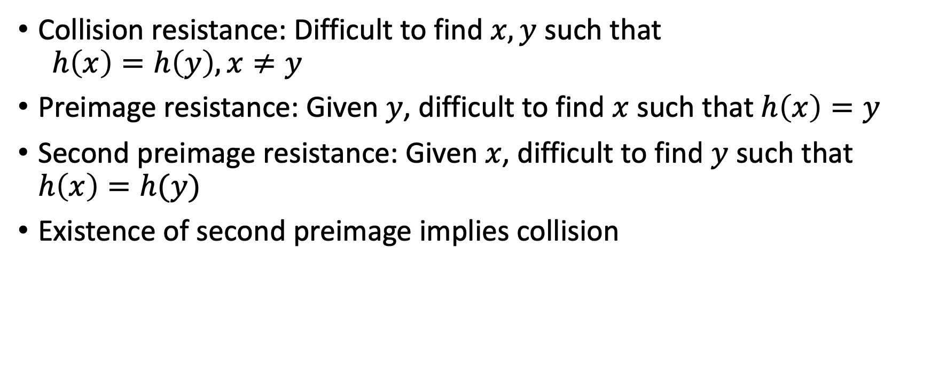
Hash function security
Collision resistance: Difficult to find $x,y$ such that $h\left(x\right)=h\left(y\right), x≠y$
Preimage resistance: Given $y$, difficult to find $x$ such that $h\left(x\right)=y$
Second preimage resistance: Given $x$, difficult to find $y$ such that $h\left(x\right)=h(y)$
Existence of second preimage implies collision

Slide 66
Merkle-Patricia Trie Details

